Slide 1
Predicate Analytics
Dr. Ravirajsinh S. Vaghela
Assistant Professor,
School of Cyber Security & Digital Forensics, NFSU, Gandhinagar Campus.

Slide 2
Outline
Linear Regression
Regression basics
Relationship between attributes using Covariance and Correlation
Relationship between multiple variables
Regression (Linear, Multivariate) in prediction
Residual Analysis,
Identifying significant features,
Hypothesis testing of Regression Model

Slide 3
Linear Regression
Linear regression is a type of supervised machine learning algorithm that computes the linear relationship between a dependent variable and one or more independent features.
When the number of the independent feature, is 1 then it is known as Univariate Linear regression, and in the case of more than one feature, it is known as multivariate linear regression.

Slide 4
Regression
Regression analysis, like most multivariate statistics, allows you to infer that there is a relationship between two or more variables. These relationships are seldom exact because there is variation caused by many variables, not just the variables being studied.

Slide 5
Example
If you say that students who study more make better grades, you are really hypothesizing that there is a positive relationship between one variable, studying, and another variable, grades. You could then complete your inference and test your hypothesis by gathering a sample of (amount studied, grades) data from some students and use regression to see if the relationship in the sample is strong enough to safely infer that there is a relationship in the population.
Notice that even if students who study more make better grades, the relationship in the population would not be perfect; the same amount of studying will not result in the same grades for every student (or for one student every time).

Slide 6
Student
Some students are taking harder courses, like chemistry or statistics; some are smarter; some study effectively; and some get lucky and find that the professor has asked them exactly what they understood best. For each level of amount studied, there will be a distribution of grades.
If there is a relationship between studying and grades, the location of that distribution of grades will change in an orderly manner as you move from lower to higher levels of studying.

Slide 7
Regression analysis
Regression analysis is one of the most used and most powerful multivariate statistical techniques for it infers the existence and form of a functional relationship in a population.
Once you learn how to use regression, you will be able to estimate the parameters — the slope and intercept — of the function that links two or more variables.
With that estimated function, you will be able to infer or forecast things like unit costs, interest rates, or sales over a wide range of conditions.
Though the simplest regression techniques seem limited in their applications, statisticians have developed a number of variations on regression that greatly expand the usefulness of the technique.

Slide 8
What is regression?
The definition of a function can be formal, like the one in my freshman calculus text: “A function is a set of ordered pairs of numbers (x,y) such that to each value of the first variable (x) there corresponds a unique value of the second variable (y)” (Thomas, 1960).
More intuitively, if there is a regular relationship between two variables, there is usually a function that describes the relationship. Functions are written in a number of forms.
The most general is y = f(x), which simply says that the value of y depends on the value of x in some regular fashion, though the form of the relationship is not specified

Slide 9
.
α and β are parameters, remaining constant as x and y change. α is the intercept and β is the slope. If the values of α and β are known, you can find the y that goes with any x by putting the x into the equation and solving.
There can be functions where one variable depends on the values values of two or more other variables where x₁ and x₂ together determine the value of y.
There can also be non-linear functions, where the value of the dependent variable (y in all of the examples we have used so far) depends on the values of one or more other variables, but the values of the other variables are squared, or taken to some other power or root or multiplied together, before the value of the dependent variable is determined.

Slide 10
Estimate
Regression allows you to estimate directly the parameters in linear functions only, though there are tricks that allow many non-linear functional forms to be estimated indirectly.
Regression also allows you to test to see if there is a functional relationship between the variables, by testing the hypothesis that each of the slopes has a value of zero.

Slide 11
Why Linear Regression is Important?
The interpretability of linear regression is a notable strength.
The model’s equation provides clear coefficients that elucidate the impact of each independent variable on the dependent variable, facilitating a deeper understanding of the underlying dynamics.
Its simplicity is a virtue, as linear regression is transparent, easy to implement, and serves as a foundational concept for more complex algorithms.
Linear regression is not merely a predictive tool; it forms the basis for various advanced models. Techniques like regularization and support vector machines draw inspiration from linear regression, expanding its utility. Additionally, linear regression is a cornerstone in assumption testing, enabling researchers to validate key assumptions about the data.

Slide 12
Types of Linear Regression
Simple Linear Regression
This is the simplest form of linear regression, and it involves only one independent variable and one dependent variable. The equation for simple linear regression is:
where:
Y is the dependent variable
X is the independent variable
β0 is the intercept
β1 is the slope

Slide 13
Multiple Linear Regression
This involves more than one independent variable and one dependent variable. The equation for multiple linear regression is:
where:
Y is the dependent variable
X1, X2, …, Xp are the independent variables
β0 is the intercept
β1, β2, …, βn are the slopes

Slide 14
Best Fit Line
The goal of the algorithm is to find the best Fit Line equation that can predict the values based on the independent variables.
In regression set of records are present with X and Y values and these values are used to learn a function so if you want to predict Y from an unknown X this learned function can be used.
In regression we have to find the value of Y, So, a function is required that predicts continuous Y in the case of regression given X as independent features.

Slide 15
What is the best Fit Line?
Our primary objective while using linear regression is to locate the best-fit line, which implies that the error between the predicted and actual values should be kept to a minimum. There will be the least error in the best-fit line.
The best Fit Line equation provides a straight line that represents the relationship between the dependent and independent variables. The slope of the line indicates how much the dependent variable changes for a unit change in the independent variable(s).

Slide 16
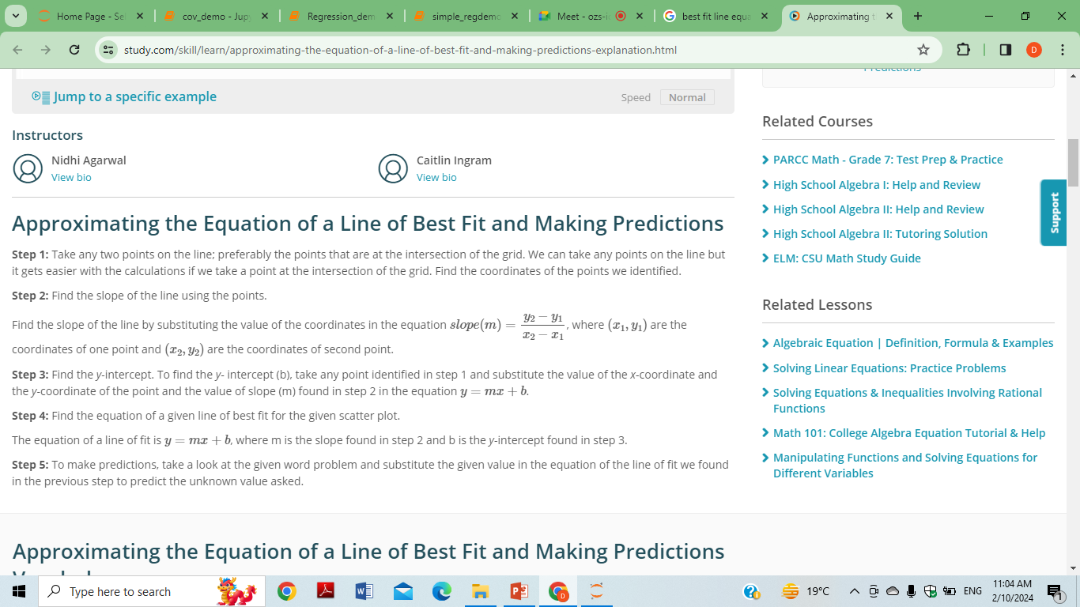

Slide 17
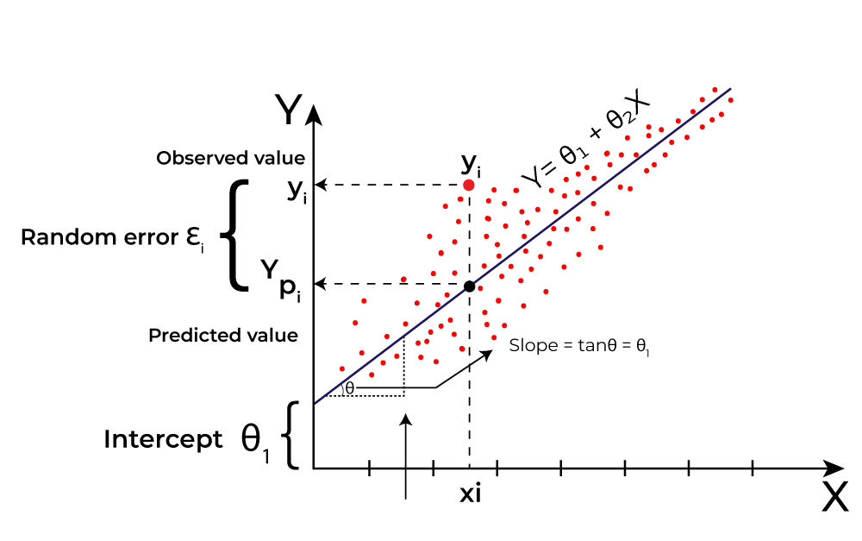

Slide 18
Y= Dependent or Targets variable
Here Y is called a dependent or target variable and X is called an independent variable also known as the predictor of Y. There are many types of functions or modules that can be used for regression. A linear function is the simplest type of function. Here, X may be a single feature or multiple features representing the problem.
Linear regression performs the task to predict a dependent variable value (y) based on a given independent variable (x)). Hence, the name is Linear Regression. In the figure above, X (input) is the work experience and Y (output) is the salary of a person. The regression line is the best-fit line for our model.
We utilize the cost function to compute the best values in order to get the best fit line since different values for weights or the coefficient of lines result in different regression lines.

Slide 19
How Are Covariance And Correlation Relevant To Data Analytics?
Covariance and correlation greatly aid in understanding the relationship between two continuous variables.
Covariance indicates whether two variables fluctuate in the same (positive covariance) or opposite direction (negative covariance).
The numerical value of covariance has no importance; only the sign is relevant.
Correlation, on the other hand, describes how a change in one variable leads to a change in the percentage of the second variable. Correlation ranges from -1 to +1.
If the correlation value is 0, it suggests that there is no linear link between the variables, but another functional relationship may exist.

Slide 20
What Is Covariance?
Covariance is a statistical term that refers to a systematic relationship between two random variables in which a change in the other reflects a change in one variable.
The covariance value can range from -∞ to +∞, with a negative value indicating a negative relationship and a positive value indicating a positive relationship.
The greater this number, the more reliant the relationship. Positive covariance denotes a direct relationship and is represented by a positive number.
A negative number, on the other hand, denotes negative covariance, which indicates an inverse relationship between the two variables.
Covariance is great for defining the type of relationship, but it's terrible for interpreting the magnitude.

Slide 21
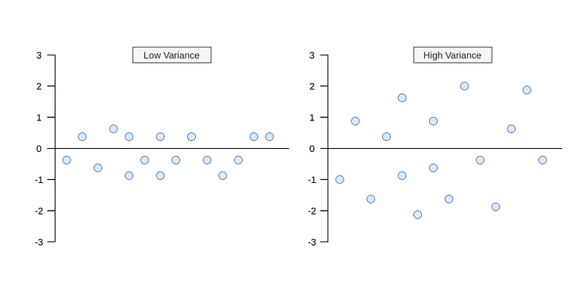

Slide 22

Equation of Covariance
Let Σ(X) and Σ(Y) be the expected values of the variables, the covariance formula can be represented as.
Where,
xi = data value of x
yi = data value of y
x̄ = mean of x
ȳ = mean of y
N = number of data values.

Slide 23
Variance & Covariance
Variance and SD are purely 1-dimensional.
Data sets like this could be: height of all the people in the room,marks for the last ML exam etc.
However many data sets have more than one dimensions , an the aim of the statistical analysis of these data sets is usually to see if there is any relationship between the dimensions.
For example, we might have as our data set both the height of all the students in a class,and the mark they received for that paper.
We could then perform statistical analysis to see if the height of a student has any effect on their mark.It is useful to have measure to find out how much the dimensions vary from the mean with respect o each other.
Covariance is such a measure.it is always measured between 2 dimensions.If we calculate the covariance between one dimension and itself, you get the variance.So if we had a three dimensional data set (x,y,z), then we could measure the covariance between the x and y dimensions, the x and z dimensions, and the y and z dimensions.
Measuring the covariance between x and x, or y and y , or z and z would give us the variance of the x,y and z dimensions respectively.

Slide 24
Standard Deviation (SD):
What it measures: SD quantifies how spread out a set of data values is from its average (mean). A higher SD indicates more spread, while a lower SD indicates values closer to the mean.
Formula:
SD = sqrt(sum((x - mean)^2) / (n - 1))
x: a data value
mean: the average of all data values (calculated as sum(x)/n)
n: the number of data values
^2: squaring
Real-world example:
Imagine comparing test scores in two classes. Class A's SD might be 10 points, meaning scores vary more widely from the average, while Class B's SD of 5 points suggests scores are more clustered around the mean.

Slide 25
Variance:
What it measures: Variance is the average squared deviation from the mean. It essentially tells you what the average squared distance of each data point is from the mean.
Formula:
Variance = sum((x - mean)^2) / (n - 1)
Same definitions as in the SD formula.
Real-world example:
Continuing with the test scores analogy, Class A's variance might be 100 points^2, while Class B's is 25 points^2.
This reflects the same spread pattern as SD but expresses it in squared units.

Slide 26
How does this work ?
Imagine we have gone into the world and collected some 2-dimensional data,say we have asked a bunch of students how many hours in total that they spent studying ML , and the mark that they received . So we have two dimensions, the first is the H dimension, the hours studied, and the second is the M dimension,the mark received.
So what does the covariance between H and M tells us ?
The exact value is not as important as it's sign(ie. positive or negative).
if the value is positive, then that indicates that both dimensions increase together, meaning that, in general, as the number of hours of study increased,so did the final mark.
If the value is negative,then as one dimension increase the other decreases.
If we had ended up with a negative covariance then would mean opposite, that as the number of hours of study increased the final mark decreased.
In the last case, if the covariance is zero,it indicates that the two dimensions are independent of each other.

Slide 27
Types of Covariance
Covariance can be either positive or negative. It is classified into two sorts based on this
Positive Covariance
A positive covariance between two variables indicates that they are heading in the same direction. The variables, in this case, behave similarly. That is, if the values of one variable (more or smaller) correspond to the values of another variable, they are said to be in positive covariance.
Negative Covariance
When two variables have a negative covariance, the variables shift in the opposite direction. It is the inverse of positive covariance, in which higher values of one variable correlate to lower values of another and vice versa.

Slide 28
Application Of Covariance
Simulating systems with multiple correlated variables is done using Cholesky decomposition.
A covariance matrix helps determine the Cholesky decomposition because it is positive semi-definite.
The matrix is decomposed by the product of the lower matrix and its transpose.
To reduce the dimensions of large data sets, principal component analysis is used.
To perform principal component analysis, an eigen decomposition is applied to the covariance matrix

Slide 29
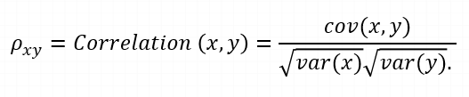
What Is Correlation?
In statistics, correlation is a measure that determines the degree to which two or more random variables move in sequence.
When an equivalent movement of another variable reciprocates the movement of one variable in some way or another during the study of two variables, the variables are said to be correlated. The formula for correlation is:
where,
var(X) = standard deviation of X
var(Y) = standard deviation of Y
Positive correlation occurs when two variables move in the same direction. When variables move in the opposite direction, they are said to be negatively correlated.

Slide 30
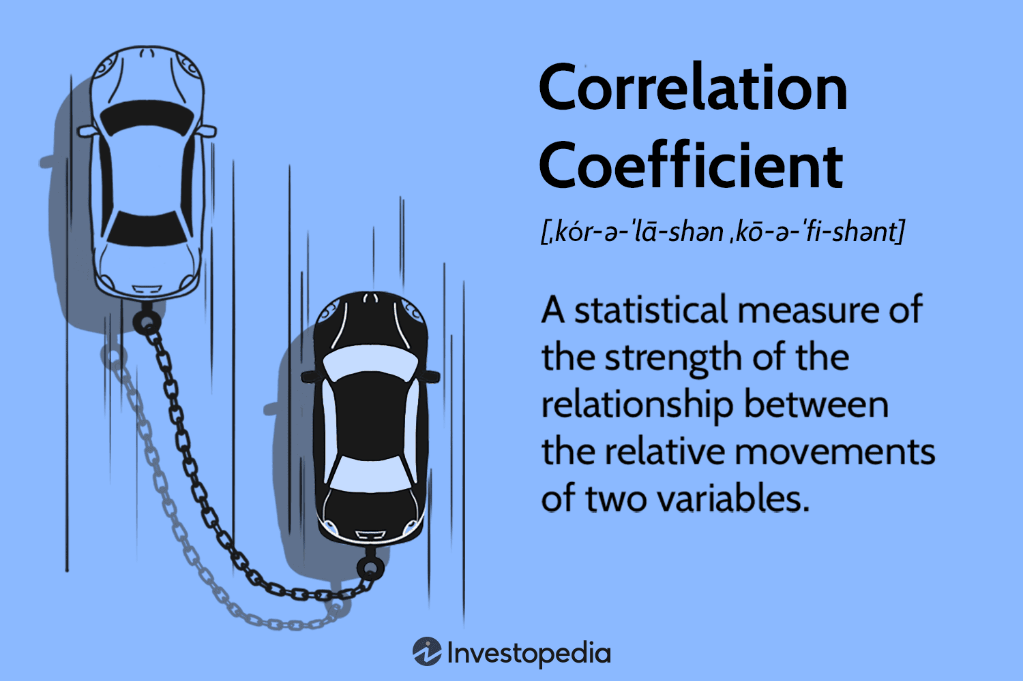

Slide 31
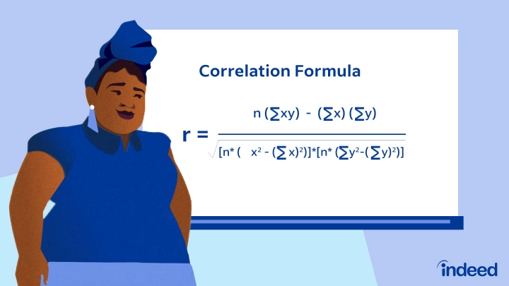

Slide 32
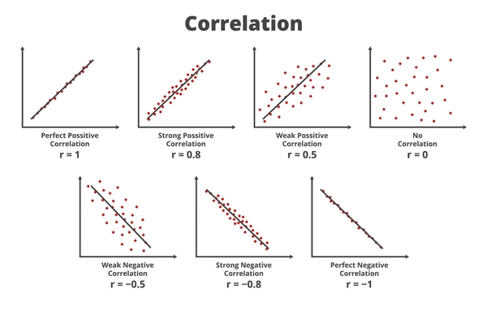

Slide 33
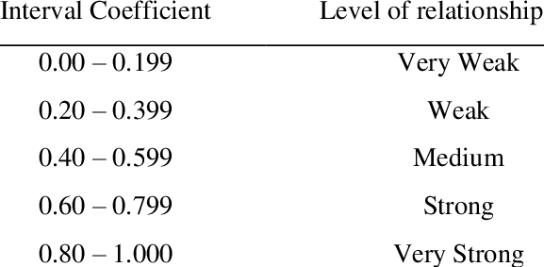

Slide 34
Correlation is of three types:
Simple Correlation: In simple correlation, a single number expresses the degree to which two variables are related.
Partial Correlation: When one variable's effects are removed, the correlation between two variables is revealed in partial correlation.
Multiple correlation: A statistical technique that uses two or more variables to predict the value of one variable

Slide 35
Applications of Correlation
A correlation matrix is computed for three main reasons:
The goal when dealing with large amounts of data is to find patterns. As a result, a correlation matrix is used to look for a pattern in the data and determine whether the variables are highly correlated.
For use in other analyses. When excluding missing values pairwise, correlation matrices are commonly used as inputs for exploratory factor analysis, confirmatory factor analysis, structural equation models, and linear regression.
When checking other analyses, as a diagnostic. When it comes to linear regression, for example, a large number of correlations indicate that the linear regression estimates will be unreliable.

Slide 36
Correlation Vs Covariance
Basis for comparison | Covariance | Correlation
Definition | Covariance is an indicator of the extent to which 2 random variables are dependent on each other. A higher number denotes higher dependency. | Correlation is a statistical measure that indicates how strongly two variables are related.
Values | The value of covariance lies in the range of -∞ and +∞. | Correlation is limited to values between the range -1 and +1
Change in scale | Affects covariance | Does not affect the correlation
Unit-free measure | No | Yes

Slide 37
Similarities: Covariance vs Correlation
Correlation and Covariance both measure only the linear relationships between two variables.
This means that when the correlation coefficient is zero, the covariance is also zero.
Both correlation and covariance measures are also unaffected by the change in location.
However, when it comes to making a choice between covariance vs correlation to measure relationship between variables, correlation is preferred over covariance because it does not get affected by the change in scale

Slide 38
Correlation vs. Regression
Correlation | Regression
Correlation is used to determine whether variables are related or not. | Regression is used to numerically describe how a dependent variable changes with a change in an independent variable
Correlation tries to establish a linear relationship between variables. | It finds the best-fitted regression line to estimate an unknown variable on the basis of the known variable.
The variables can be used interchangeably | The variables cannot be interchanged.
Correlation uses a signed numerical value to estimate the strength of the relationship between the variables. | Regression is used to show the impact of a unit change in the independent variable on the dependent variable.
The Pearson's coefficient is the best measure of correlation. | The least-squares method is the best technique to determine the regression line.

Slide 39
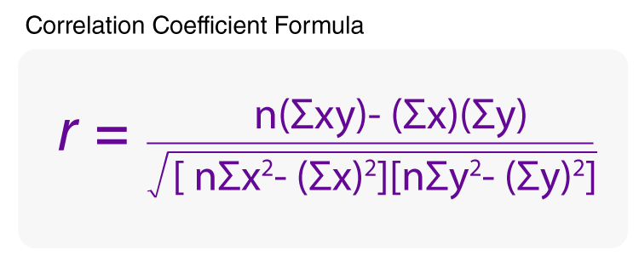

Slide 40
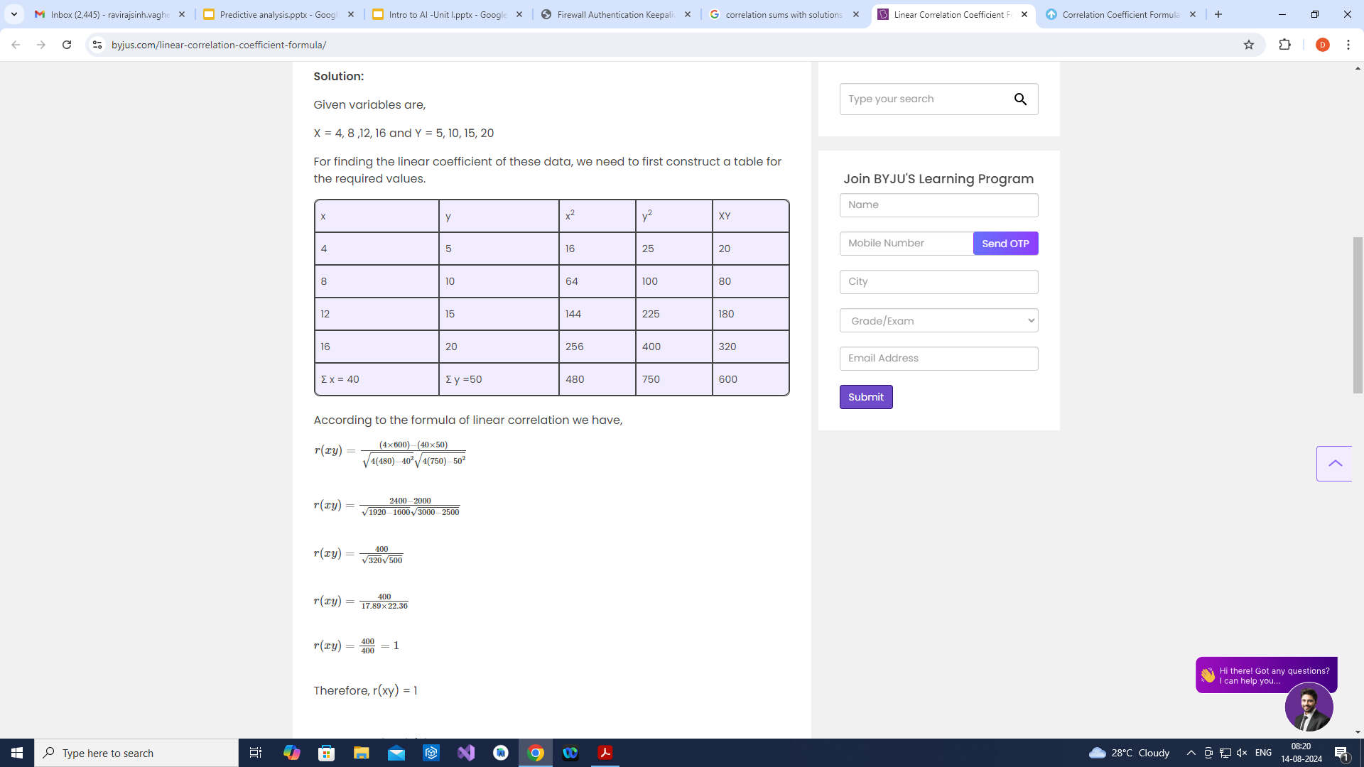
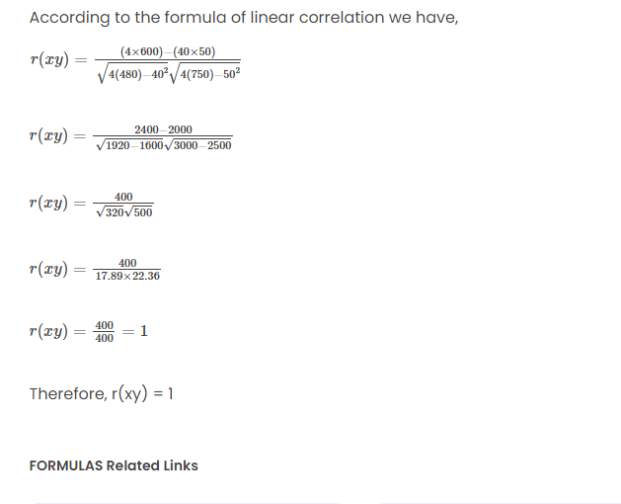

Slide 41
Example
Person | Hand | Height
A | 17 | 150
B | 15 | 154
C | 19 | 169
D | 17 | 172
E | 21 | 175

Slide 42
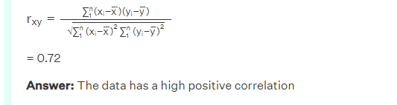
Person | Hand | Height | (x_{i} - x̄) | yi−¯¯¯y | (x_{i} - x̄)(y_{i} - ¯¯¯y2¯) | (x_{i} - x̄)² | (y_{i} - ¯¯¯y�¯)²
A | 17 | 150 | -0.8 | -14.0 | 11.2 | 0.6 | 196.0
B | 15 | 154 | -2.8 | -10.0 | 28.0 | 7.8 | 100.0
C | 19 | 169 | 1.2 | 5.0 | 6.0 | 1.4 | 25.0
D | 17 | 172 | -0.8 | 8.0 | -6.4 | 0.6 | 64.0
E | 21 | 175 | 3.2 | 11.0 | 35.2 | 10.2 | 121.0
Average | 17.8 | 164 |  | Total | 74.0 | 20.8 | 506.0

Slide 43
Regression Line
Person | Weight | Blood Pressure | (x_{i} - x̄) | yi−¯¯¯y | (x_{i} - x̄)² | (y_{i} - ¯¯¯y¯)²
A | 150 | 125 | -24.8 | -21.8 | 615.0 | 475.2
B | 169 | 130 | -5.8 | -16.8 | 33.6 | 282.2
C | 175 | 160 | 0.2 | 13.2 | 0.0 | 174.2
D | 180 | 169 | 5.2 | 22.2 | 27.0 | 492.8
E | 200 | 150 | 25.2 | 3.2 | 635.0 | 10.2
Average | 174.8 | 146.8 |  | Total | 1310.8 | 1434.8

Slide 44
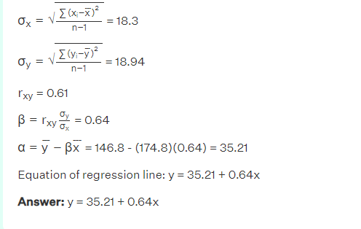

Slide 45
Residual Analysis….
Imagine you're trying to fit a line through a bunch of data points. The best-fit line will minimize the distances between the points and the line. These distances are called the residuals.
Residual analysis is the process of examining these residuals to see how well the line fits the data. There are a few different ways to do this, but some common methods include:

Slide 46
Example…
Scenario: Imagine you're studying the relationship between study hours (independent variable) and exam scores (dependent variable) for a group of students. You suspect a linear relationship.
Step 1: Fit the Regression Line: Use a statistical software or calculator to fit a linear regression line to the data. This will give you the equation of the line and the predicted score for each student based on their study hours.
Step 2: Calculate Residuals: For each student, calculate the difference between their actual exam score and their predicted score. This difference is the residual.

Slide 47
Example
Student | Study Hours | Exam Score | Predicted Score | Residual
A | 5 | 80 | 78 | 2
B | 3 | 70 | 69 | 1
C | 8 | 95 | 90 | 5
D | 6 | 84 | 81 | 3
E | 2 | 65 | 64 | 1

Slide 48
Different technique to Analysis of Residual
Plotting the residuals against the independent variable: This can help you see if there are any patterns in the residuals, such as if they tend to be larger for higher or lower values of the independent variable.
Plotting the residuals against the fitted values: This can help you see if the variance of the residuals is constant across the range of fitted values.
Normal probability plot of the residuals: This can help you see if the residuals are normally distributed, which is an important assumption of linear regression.

Slide 49
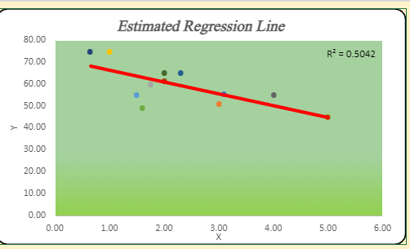
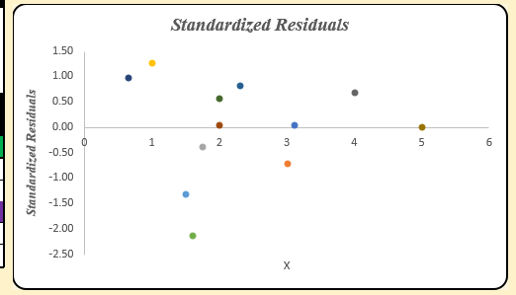
Compare
Regression Line
Standardized Residuals

Slide 50
Patterns in the Residuals
If you see any patterns in the residuals, it may indicate that your model is not a good fit for the data.
You may need to try a different model, or transform your data in some way.
Residuals are always measured in the same units as the dependent variable.
The sum of the residuals is always zero.
The average residual is always zero.

Slide 51
Identifying significant features
Imagine you're a detective trying to solve a case. You have tons of clues (features) scattered around, but not all of them are equally helpful in catching the culprit (target variable). You need to figure out which clues are the most informative and focus your investigation there.
That's what feature selection does in statistics and machine learning! It helps us identify the most important features from a large dataset to improve the performance of our analysis or model.

Slide 52
Benefits of using F-test for feature selection:
Simple and interpretable: The F-score directly relates to the feature's explanatory power.
Works well for numerical features: Suitable for continuous data like age, income, or exam scores
F-test assumes normal distribution of data. Consider transformations if needed.
It favors features with many unique values. Be cautious with categorical features with few categories.

Slide 53
F-test
F-test is a specific technique for feature selection. It's like a statistical competition between features, judging which ones best explain the target variable. Here's the basic idea:
Divide the data: Split your data into two groups based on the target variable (e.g., high vs. low exam scores).
Compare variances: For each feature, calculate how spread out its values are within each group (variance).
Score the features: Calculate an F-score for each feature, which compares the between-group variance (how different the groups are) to the within-group variance (how spread out each group is).
Pick the winners: Features with higher F-scores are considered more important because their differences between groups are significant. Choose a selection based on a threshold or desired number of features.
Think of it like comparing how much taller students are in the "tall" group versus the "short" group. Features with larger differences (taller F-scores) likely contribute more to understanding the "tall" category.

Slide 54
What is F Test in Statistics?
F test is a statistical test that is used in hypothesis testing to check whether the variances of two populations or two samples are equal or not.
In an f test, the data follows an f distribution. This test uses the f statistic to compare two variances by dividing them. An f test can either be one-tailed or two-tailed depending upon the parameters of the problem.
The f value obtained after conducting an f test is used to perform the one-way ANOVA (analysis of variance) test.

Slide 55
What is F Test in Statistics?
F test is statistics is a test that is performed on an f distribution. A two-tailed f test is used to check whether the variances of the two given samples (or populations) are equal or not.
However, if an f test checks whether one population variance is either greater than or lesser than the other, it becomes a one-tailed hypothesis f test.

Slide 56
F Test Definition
F test can be defined as a test that uses the f test statistic to check whether the variances of two samples (or populations) are equal to the same value. To conduct an f test, the population should follow an f distribution and the samples must be independent events.
On conducting the hypothesis test, if the results of the f test are statistically significant then the null hypothesis can be rejected otherwise it cannot be rejected.
“The F-test formula one may use to perform the statistical test that helps the person conducting the test find whether the two population sets having the normal distribution of the data points have the same standard deviation.”

Slide 57
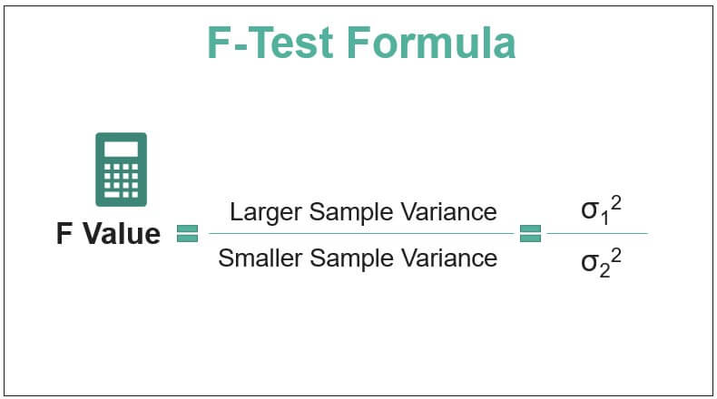
F Test Formula
The f test is used to check the equality of variances using hypothesis testing. The f test formula for different hypothesis tests is given as follows:

Slide 58
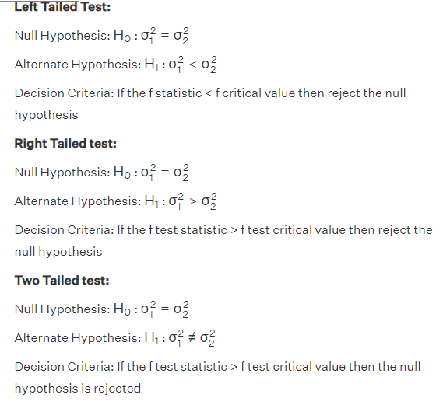

Slide 59
Calculate F Test
Firstly, frame the null and alternate hypothesis.The null hypothesis assumes that the variances are equal. H₀: σ₁² = σ₂². The alternate hypothesis states that the variances are unequal. H₁: σ₁² ≠ σ₂². Here, σ₁² and σ₂² are the symbols for variances.
Calculate the test statistic.(F distribution). i.e., = σ₁² / σ₂² Where σ₁² is assumed to be larger sample variance, and σ₂² is the smaller sample variance

Slide 60
Next Step
Calculate the degrees of freedom.Degree of freedom (df1) = n1 – 1 and Degree of freedom (df2) = n2 – 1 where n1 and n2 are the sample sizes.
Look at the F value in the F table.For two-tailed tests, divide the alpha by 2 to find the correct critical value.
Thus, the F-value is found by looking at the degrees of freedom in the numerator and the denominator in the F-table
. Df1 is read across in the top row. Df2 is read down in the first column.

Slide 61
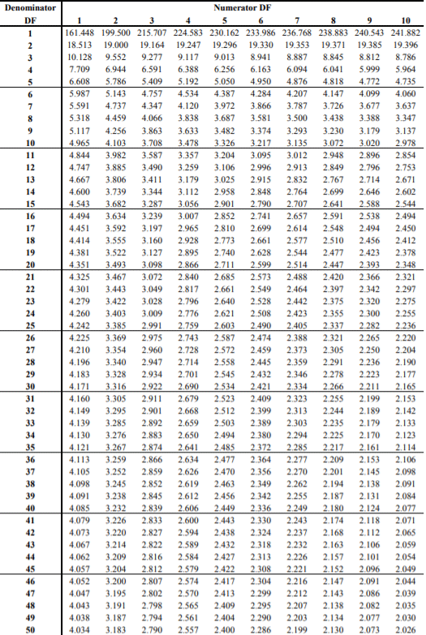
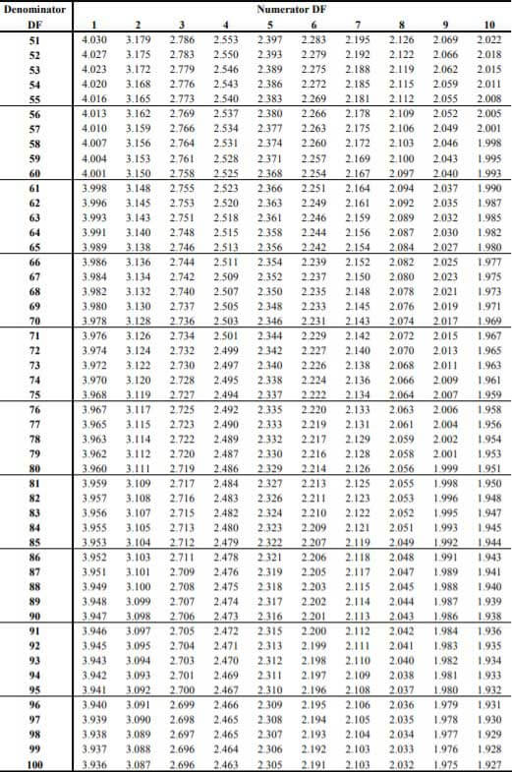
Note: There are different F Tables for different levels of significance. Above is the F table for alpha = .050.

Slide 62
F-test caluclation
Example 1: A research team wants to study the effects of a new drug on insomnia. 8 tests were conducted with a variance of 600 initially. After 7 months 6 tests were conducted with a variance of 400. At a significance level of 0.05 was there any improvement in the results after 7 months?
Bigger sizer=600 size8-1
Smaller size =400 size=6-1

Slide 63
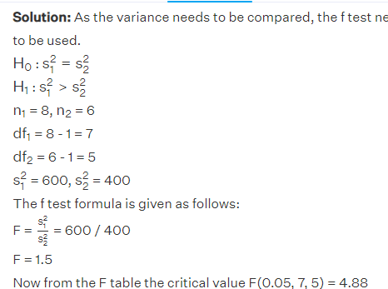
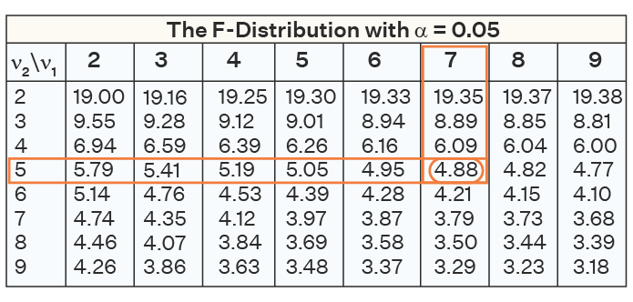
Fail to reject the null hypothesis.
As 1.5 < 4.88, thus, the null hypothesis cannot be rejected and there is not enough evidence to
conclude that there was an improvement in insomnia after using the new drug.

Slide 64
Take away
The F-test formula is used to conduct a statistical test determining whether two population sets with normally distributed data points have the same standard deviation.
The F-test can be used to test the hypothesis of equal variances between two populations.
It can also be used to test the hypothesis of equal means between normally distributed populations with the same standard deviation.
The F-test is commonly employed to assess the fit of a proposed regression model to the data, evaluating how well the model explains the variability in the data.

Slide 65
Hypothesis testing – Regression model
Hypothesis testing in regression models helps you assess the statistical significance of your findings and draw valid conclusions.
Imagine you're making a prediction: You're studying how much sleep (independent variable) affects exam scores (dependent variable). You fit a regression line, but how confident are you that this line represents a real relationship, not just random chance?

Slide 66
Set up your detective work:
Null hypothesis (H0): There's NO significant relationship between sleep and exam scores. The observed relationship could be due to chance.
Alternative hypothesis (Ha): There's a REAL, non-zero relationship between sleep and exam scores.
Gather evidence (data): You analyze your exam scores and sleep data.
Analyze the evidence: You perform statistical tests (like F-test or t-test) that calculate a p-value. This tells you the probability of seeing the observed results IF the null hypothesis were true (no real relationship).
Make a decision:
Low p-value (e.g., < 0.05): Reject the null hypothesis. The evidence strongly suggests a real relationship between sleep and scores.
High p-value (e.g., > 0.05): Don't reject the null hypothesis. The observed relationship could be due to chance, and more evidence is needed.

Slide 67
References
https://opentextbc.ca/introductorybusinessstatistics/chapter/regression-basics-2/
https://www.geeksforgeeks.org/ml-linear-regression/
https://www.analyticsvidhya.com/blog/2021/10/everything-you-need-to-know-about-linear-regression/
http://www.stat.yale.edu/Courses/1997-98/101/linreg.htm
https://www.spiceworks.com/tech/artificial-intelligence/articles/what-is-linear-regression/
https://www.simplilearn.com/covariance-vs-correlation-article
https://builtin.com/data-science/covariance-vs-correlation
https://learn.saylor.org/mod/book/view.php?id=61394&chapterid=49774
https://byjus.com/maths/correlation-and-regression/
https://towardsdatascience.com/covariance-and-correlation-321fdacab168
https://study.com/academy/lesson/covariance-correlation-equations-examples.ht
https://www.cuemath.com/data/correlation-and-regression/

